Slide 1

Data Persistency in Android
Donny Cordova | Assistant Professor Computer Systems Engineering Technology | Oregon Institute of Technology

Slide 2
Outline
Displaying Data
Data Persistency
SQLite
DBFlow

Slide 3
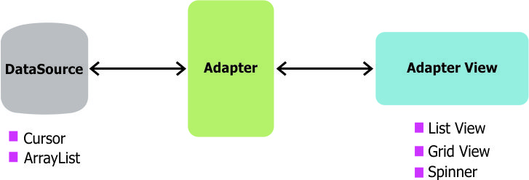
Displaying Data
In Android development, any time you want to show a vertical list of items you will want to use a ListView which is populated using an Adapter to a data source. When we want the data for the list to be sourced directly from a SQLite database query, we can use a CursorAdapter.
The CursorAdapter fits in between a Cursor (data source from SQLite query) and the ListView (visual representation) and configures two aspects:
Which layout template to inflate for an item
Which fields of the cursor to bind to which views in the template

Slide 4

SQLite

Slide 5
Introduction
SQLite is a opensource SQL database that stores data to a text file on a device. Android comes in with built in SQLite database implementation.
SQLite supports all the relational database features. In order to access this database, you don't need to establish any kind of connections for it like JDBC,ODBC e.t.c

Slide 6
Database - Package
The main package is android.database.sqlite that contains the classes to manage your own databases.

Slide 7
Example- To insert , delete and update records from a table called student.
To create a table called student
SQLiteDatabase db; db=openOrCreateDatabase("StudentDB", Context.MODE_PRIVATE, null);
db.execSQL("CREATE TABLE IF NOT EXISTS student(rollno VARCHAR,name VARCHAR,marks VARCHAR);");

Slide 8
SQLiteDatabase db; db=openOrCreateDatabase("StudentDB", Context.MODE_PRIVATE, null);
In the above code, the openOrCreateDatabase() function is used to open the StudentDB database if it exists or create a new one if it does not exist.
The first parameter of this function specifies the name of the database to be opened or created.
The second parameter , Context.MODE_PRIVATE indicates that the database file can only be accessed by the calling application or all applications sharing the same user ID.
The third parameter left null if not required.

Slide 9
db.execSQL()
db.execSQL("CREATE TABLE IF NOT EXISTS student(rollno VARCHAR,name VARCHAR,marks VARCHAR);");
The db.execSQL() function executes any SQL command. Here it is used to create the student table if it does not already exist in the database.

Slide 10
OnCreate()
public void onCreate(Bundle savedInstanceState) { <code>super.onCreate(savedInstanceState); setContentView(R.layout.main);

Slide 11
// Initializing controls editRollno=(EditText)findViewById(R.id.editRollno); editName=(EditText)findViewById(R.id.editName); editMarks=(EditText)findViewById(R.id.editMarks); btnAdd=(Button)findViewById(R.id.btnAdd); btnDelete=(Button)findViewById(R.id.btnDelete); btnModify=(Button)findViewById(R.id.btnModify); btnView=(Button)findViewById(R.id.btnView); btnViewAll=(Button)findViewById(R.id.btnViewAll); btnShowInfo=(Button)findViewById(R.id.btnShowInfo);

Slide 12
// Registering event handlers btnAdd.setOnClickListener(this); btnDelete.setOnClickListener(this); btnModify.setOnClickListener(this); btnView.setOnClickListener(this); btnViewAll.setOnClickListener(this); btnShowInfo.setOnClickListener(this);

Slide 13
// Creating database and table db=openOrCreateDatabase("StudentDB", Context.MODE_PRIVATE, null); db.execSQL("CREATE TABLE IF NOT EXISTS student(rollno VARCHAR,name VARCHAR,marks VARCHAR);"); }

Slide 14
In the onClick() event handler, we can write the code required to add, delete, modify and view records.
The following code uses the db.execSQL() function to insert a student record in the student table.
db.execSQL("INSERT INTO student VALUES('"+editRollno.getText()+"','"+ editName.getText()+"','"+editMarks.getText()+"');");
The above code generates an INSERT statement by appending the contents of the editable fields into a string and executes the INSERT statement.

Slide 15
In the same way, the DELETE command can be executed as follows:
db.execSQL("DELETE FROM student WHERE rollno='"+editRollno.getText()+"'");
The above code deletes the record of the student whose roll number is entered in the editable field.

Slide 16
The UPDATE command can be executed as follows:
db.execSQL("UPDATE student SET name='"+editName.getText()+"',marks='"+ editMarks.getText()+"' WHERE rollno='"+editRollno.getText()+"'");

Slide 17
To view a student record
Execute a query using the rawQuery() method of the SQLiteDatabase class as follows:
Cursor c=db.rawQuery("SELECT * FROM student WHERE rollno='"+editRollno.getText()+"'", null); if(c.moveToFirst()) { editName.setText(c.getString(1)); editMarks.setText(c.getString(2)); }
The above code uses the rawQuery() method of the SQLiteDatabase class to execute the SELECT statement to select the record of the student, whose roll number is specified. It then checks if the record is found using the moveToFirst() method of the Cursor class and displays the name and marks in the respective editable fields.

Slide 18
To view all records, the following code can be used:
Cursor c=db.rawQuery("SELECT * FROM student", null);
if(c.getCount()==0)
{
showMessage("Error", "No records found"); return;
}

Slide 19
StringBuffer buffer=new StringBuffer(); while(c.moveToNext()) {
buffer.append("Rollno: "+c.getString(0)+"\n"); buffer.append("Name: "+c.getString(1)+"\n"); buffer.append("Marks: "+c.getString(2)+"\n\n"); }
showMessage("Student Details", buffer.toString());
The above code executes the SELECT command to retrieve records of all students and appends them into a string buffer. Finally, it displays the student details using the user-defined showMessage() function.

Slide 20
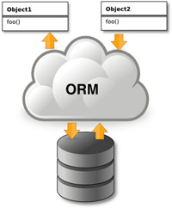
DBFlow

Slide 21
What is DBFlow?
DBFlow is an ORM wrapper (similar to N/Hibernate, Spring)
A robust, powerful, and very simple ORM android database library with annotation processing.
The library is built on speed, performance, and approachability. It not only eliminates most boiler-plate code for dealing with databases, but also provides a powerful and simple API to manage interactions.

Slide 22
DBFlow Example – Class Annotations
@Table(database = MyDatabase.class)
public class User extends BaseModel
{
@Column(name = "Name")
public String name;
@Column(name = "Age")
public int age;
// Make sure to define this constructor (with no arguments)
// If you don't querying will fail to return results!
public User() { super(); }
// Be sure to call super() on additional constructors as well
public User(String name, int age)
{
super(); this.name = name;
this.age = age;
}
}

Slide 23
Inserting / Deleting Example
User user = new User();
user.name = "Jack";
user.age = 25;
user.save();
// or delete easily too
user.delete();

Slide 24
Restricting Data – SELECT * FROM Table WHERE …
List<User> users = new Select()
.from(User.class)
.where(User_Table.age.greaterThen(25)
.limit(25)
.offset(0)
.orderBy(User_Table.age, true) // true for ASC, false for DESC
.queryList();

Slide 25
Let’s Add DBFlow to Our Projects

Slide 26
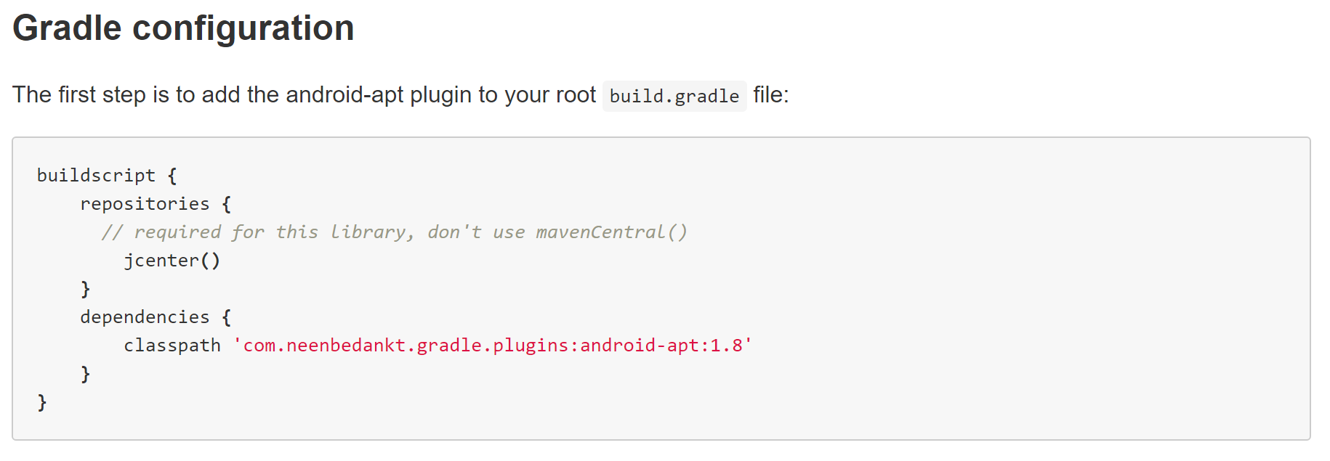
Step 1: Let’s update the gradle configuration
Notes:
buildscript {
repositories {
// required for this library, don't use mavenCentral()
jcenter()
}
dependencies {
classpath 'com.neenbedankt.gradle.plugins:android-apt:1.8'
}
}

Slide 27
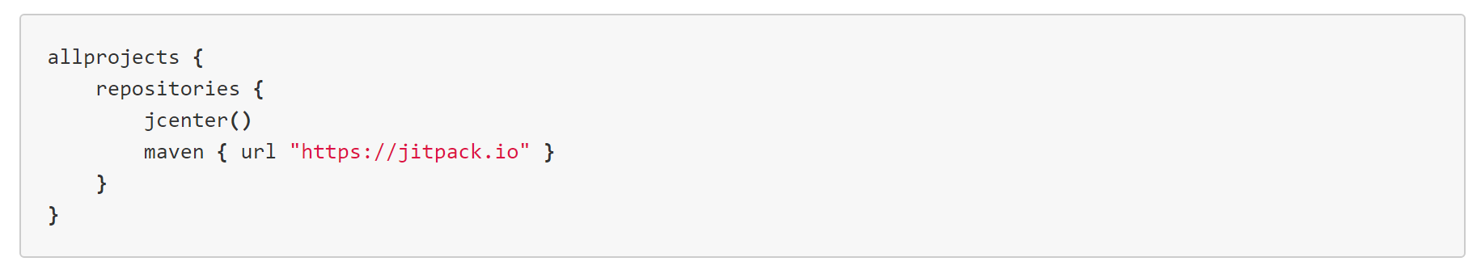
Step 2: Also add the following to main build.gradle
Notes:
allprojects { repositories { jcenter() maven { url "https://jitpack.io" } } }

Slide 28
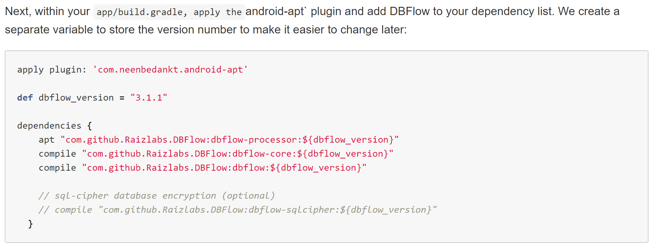
Step 3: Add to your gradle build file (module: app)
Notes:
apply plugin: 'com.neenbedankt.android-apt' def dbflow_version = "3.1.1" dependencies { apt "com.github.Raizlabs.DBFlow:dbflow-processor:${dbflow_version}" compile "com.github.Raizlabs.DBFlow:dbflow-core:${dbflow_version}" compile "com.github.Raizlabs.DBFlow:dbflow:${dbflow_version}" // sql-cipher database encryption (optional) // compile "com.github.Raizlabs.DBFlow:dbflow-sqlcipher:${dbflow_version}" }

Slide 29
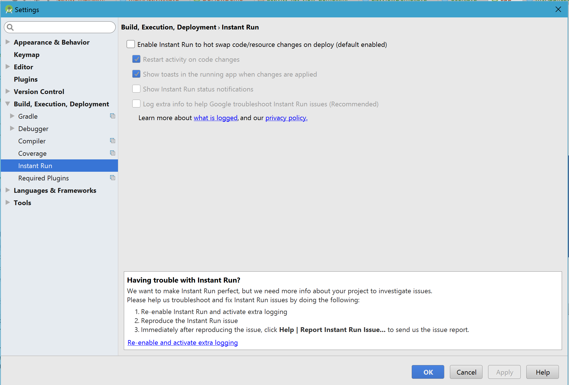
Step 4: Disable Instant Run

Slide 30
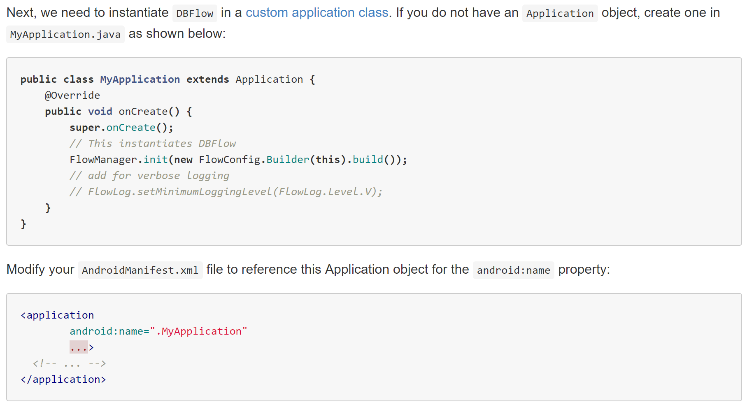
Step 5: Instantiate DBFlow in Your Application

Slide 31
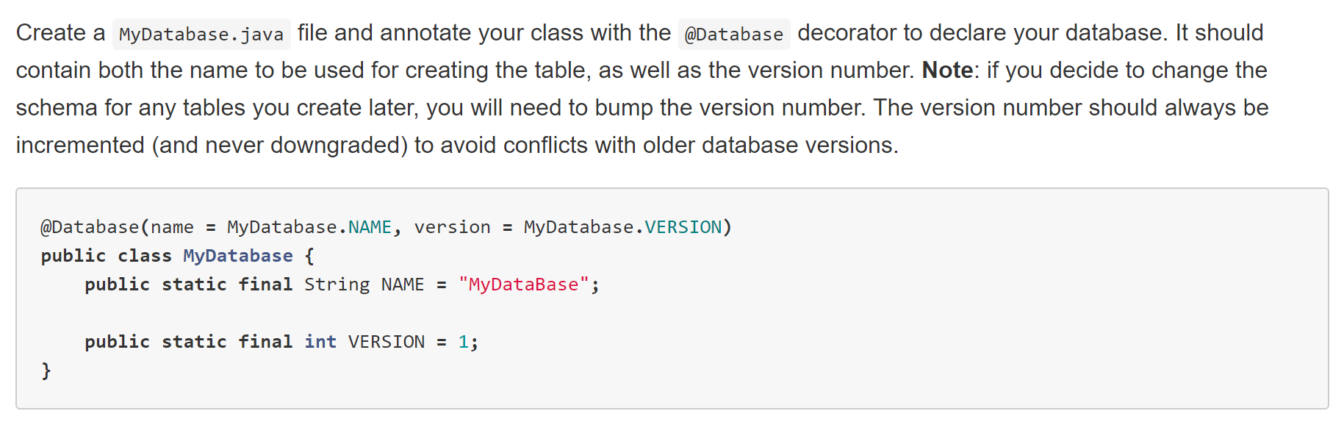
Step 6: Create the Database

Slide 32
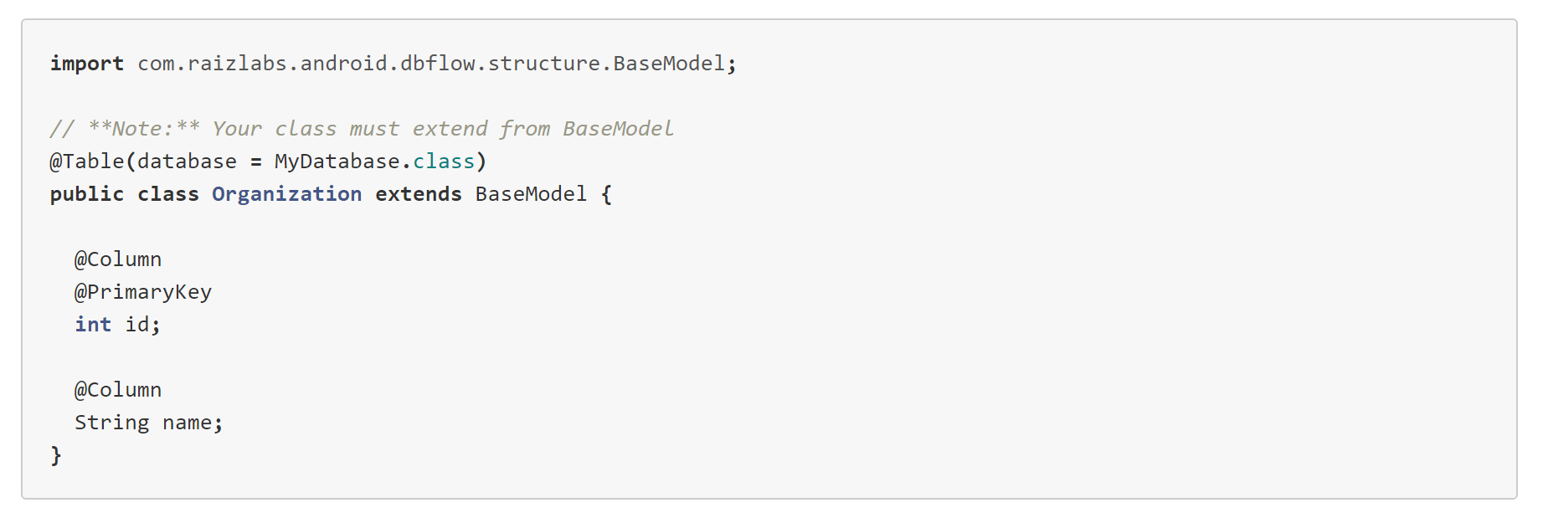
Step 7: Define your Tables as Java Classes

Slide 33
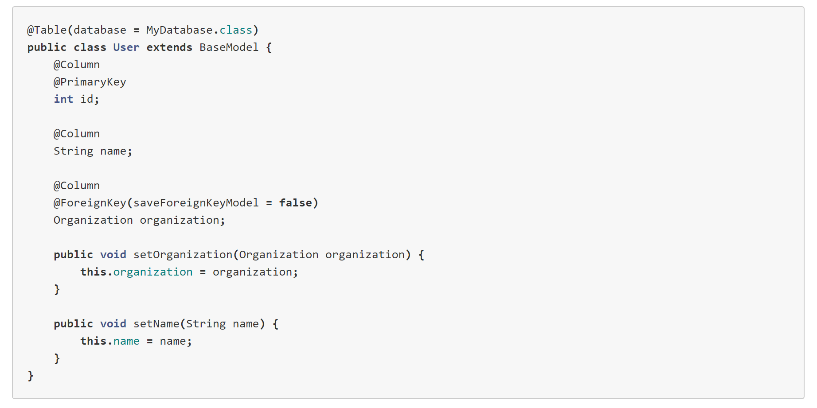
Step 7: Define your Tables as Java Classes (cont.)

Slide 34
How to View DB Data from Device/Emulator on Computer

Slide 35
Steps to View DB Data
Connect your device and launch the application in debug mode.
You may want to use adb -d shell "run-as com.yourpackge.name ls /data/data/com.yourpackge.name/databases/" to see what the database filename is.
Notice: com.yourpackge.name is your application package name. You can get it from the manifest file.
Copy the database file from your application folder to your SD card.
adb -d shell "run-as com.yourpackge.name cat /data/data/com.yourpackge.name/databases/filename.sqlite > /sdcard/filename.sqlite"
Notice: filename.sqlite is your database name you used when you created the database
Pull the database files to your machine:
adb pull /sdcard/filename.sqlite
This will copy the database from the SD card to the place where your ADB exist.
Install Firefox SQLite Manager: https://addons.mozilla.org/en-US/firefox/addon/sqlite-manager/
Open Firefox SQLite Manager (Tools->SQLite Manager) and open your database file from step 3 above.

